Slide 1

Excel From Beginner to Advance
Abhishek Anand
200MBAW013

Slide 2

Table of Content
Introduction
About the course
Objective
Benefits
Conclusion

Slide 3
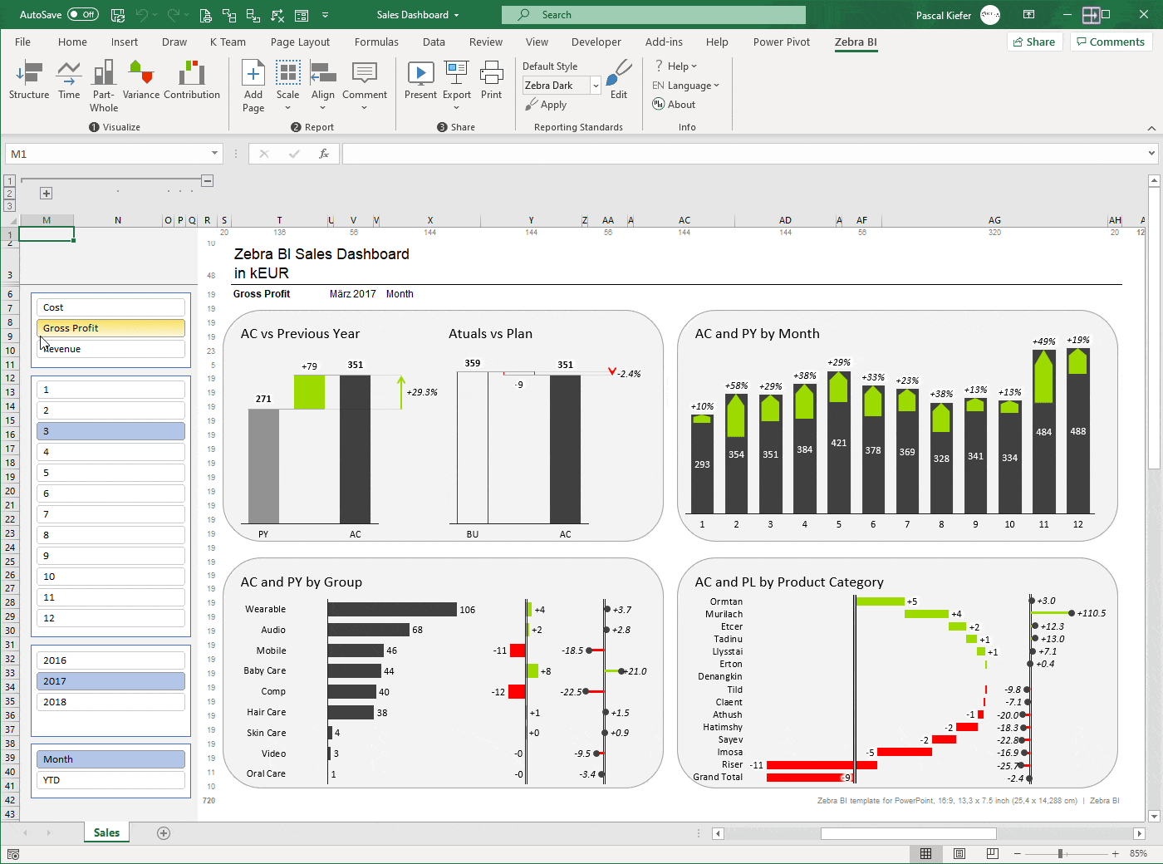

Introduction
Introduction
MS Excel is a commonly used Microsoft Office application. It is a spreadsheet program which is used to save and analyze numerical data.
Microsoft Excel has the basic features of all spreadsheets, using a grid of cells arranged in numbered rows and letter-named columns to organize data manipulations like arithmetic operations.

Slide 4
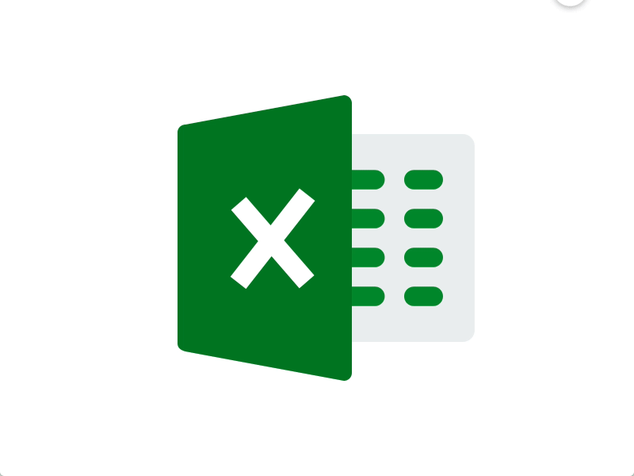
About the Course
Creating effective spreadsheets
Managing large sets of data
Mastering the use of some of Excel's most popular and highly sought after functions (SUM,COUNT IF, AVERAGE, INDEX/MATCH)
Create dynamic report with Excel PivotTables
Unlock the power and versatility of Microsoft Excel's Add-In, PowerPivot
Audit Excel Worksheet formulas to ensure clean formulas

Slide 5


Objective
Organization purpose
Real time Results
Best Visualization.
Quick and smart access.
More Secure
Data at One Place
Easy To Store Data
Easy To Recover Data
Application of Mathematical Formulas

Slide 6
Sales data chart showing of 3 years

Slide 7
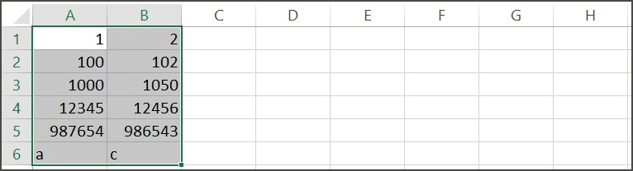
Outcomes
Best way to store data.
Insert formulas
Calculation
Simplify data
Transform clean
Clarification of the work performed in organization
So many free templates to use.
Data Visualization
Create Charts
Futuristic use

Slide 8
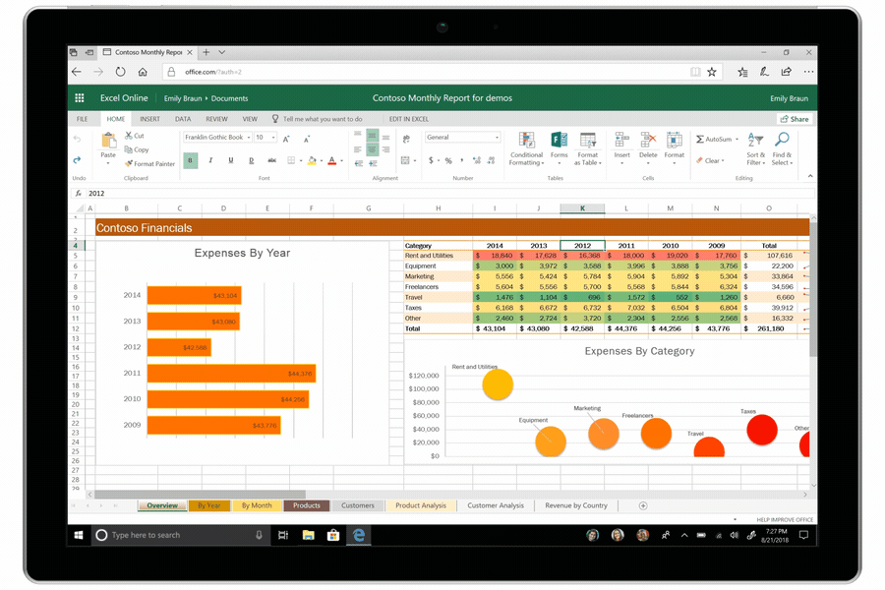
Conclusion
18+ Hours of Step by Step Video Lectures by a Microsoft Certified Trainer (MCT)(Kyle pew)
Downloadable Exercise Files to follow along and practice with.
Additional Exercise Files are provided at the end of each major section (101, 102, 103 and VBA) that you can download and practice the skills you've learned.
Section Quizzes to Test Your Knowledge on the Lecture Topics.
QA board where you can post questions, screenshots of your progress and communicate with the instructor and fellow students in the course.

Slide 9

Thank you
Abhishek Anand

